Slide 1


Ticket Dispatcher Assistant System
TDAS

Slide 2
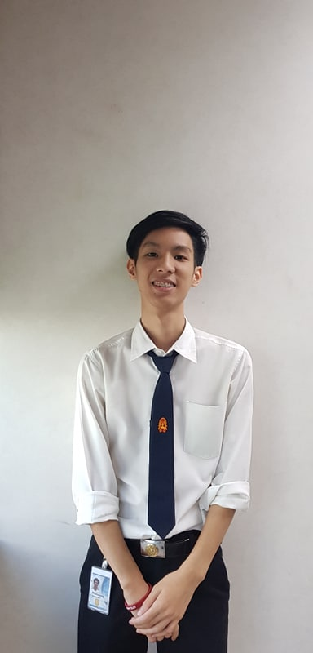
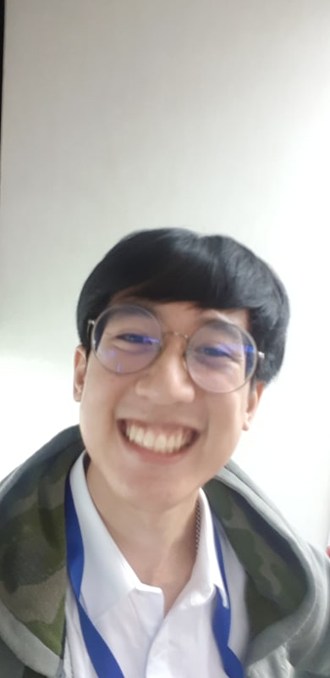
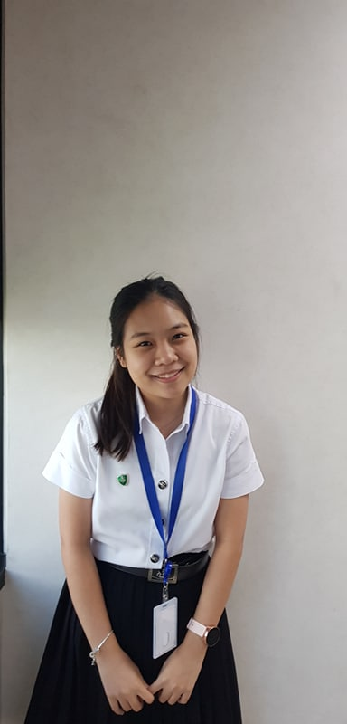
Introduction
Phanupong Rangsanseri
Warrawit Patanavanich
Weeya Weerawatpruchya
Information Technology, KMITL
Computer Engineer, KMITL
Computer Engineer, KU
Earth
Joe
Boo

Slide 3

Agenda
Internship expectation
Team background
Pain point & Solution
Work process
Demo
Intern life
Notes:
This is agenda of our presentation. we have 6 topic . Internship expectation ,team background , pain point and solution ,work process, demo and last one intern life

Slide 4
Internship expectation
Team
background
Work
process
Internship
expectation
Pain point
& Solution
Demo
Intern
life

Slide 5

Expectation
Working
experience
Technical
skills
Finding myself
New friends
Notes:
So ,First let start with our expectation. Technical skill, working experience, new friend and finding myself
about technical skill
Joe: for me . I never use agile and scrum to develop software before so I want to know
why we use agile and how to implement them to a real working enviroment
Earth: I expect to learn about software development, cloud technology, container technology, DevOps process and agile in practical
Boo: and for me I expect to learn project management and learn business process.
next about working experience
we think hard skill can be learn by ourselve but a soft skill we can learn from real working environment , obstacle that we have encountered and how we work with others.
New friend
In ExxonMobil we not work alone so we expect to work with others and make a new friend from internship
Last one finding myself
In university we only learn about coding and programming. But we never work with real business process before. We want to know that we love only coding or also love to work with business process too.

Slide 6

Team background
Team
background
Work
process
Internship
expectation
Pain point
& Solution
Demo
Intern
life

Slide 7



Financial Upstream SAP
EMIT Financial
Upstream SAP
Upstream business
Notes:
ExxonMobil's Upstream is a global leader in the exploration, development, and production of oil and natural gas resources.

Slide 8


Financial Upstream SAP
Polaris
Supernova
Thotsakan
4 teams
Scrumblers
Notes:
And our team, EMIT FI Upstream SAP, we have 4 team Thotsakan, Scrumblers, Supernova, Polaris to helping each other. Which each team is responsible for support in different regions. And we are in Thotsakan team (Thailand) which support In Asia Pacific

Slide 9










Thotsakan
Scrumblers
Supernova
Polaris
Users
Dispatcher
Ticket
IT Console
Notes:
When user have any problem . They will send that problem to our team and we call that a ticket and we have ticket dispatcher who monitor and assign that ticket to team member
every business run by financial right ? So if we have a ticket it’s mean we have a problem that it will make business stuck and delay

Slide 10
Why tickets are important?
Notes:
Why tickets are important?

Slide 11
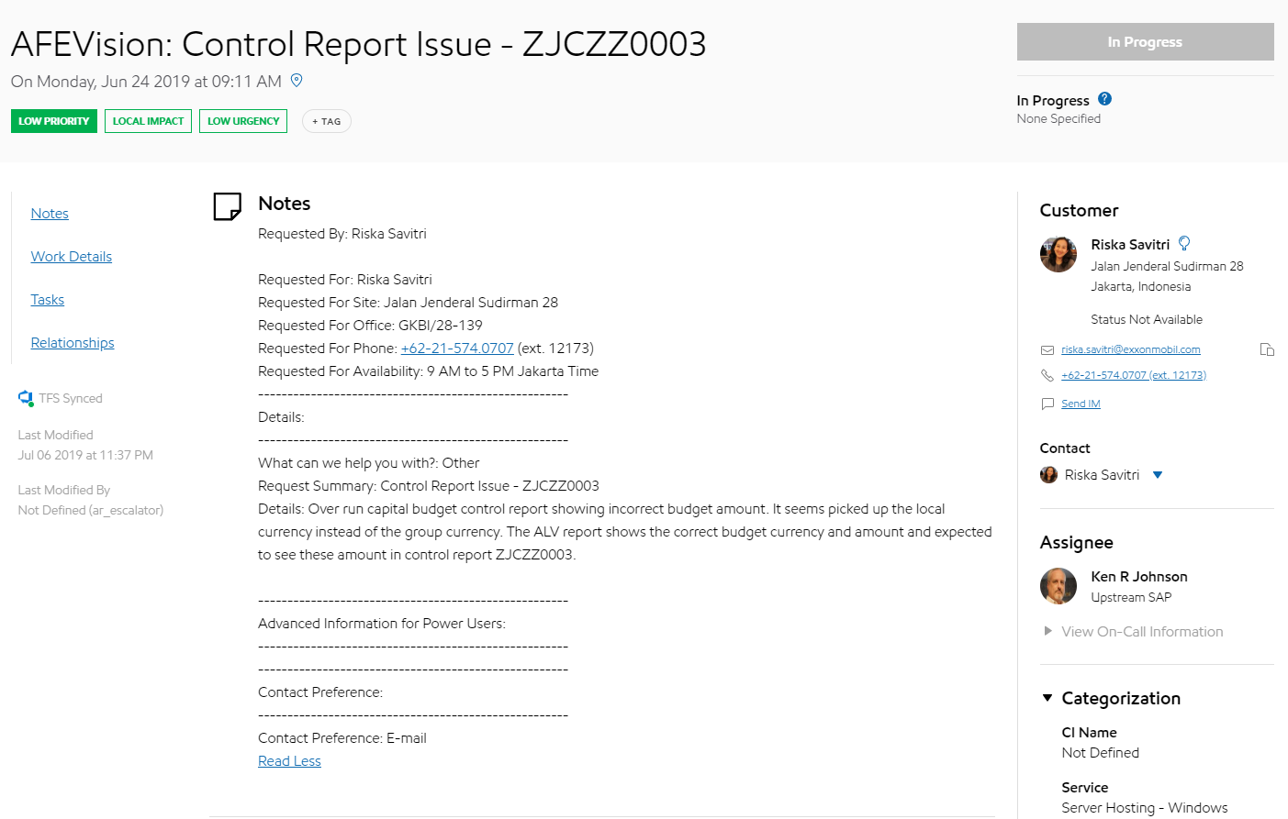
Ticket
Summary
Customer
Details
Notes:
Let’s take a look at real ticket
In the ticket will have summary of tickets (title), detail that customer write to explain more about their problem, customer who open the ticket

Slide 12
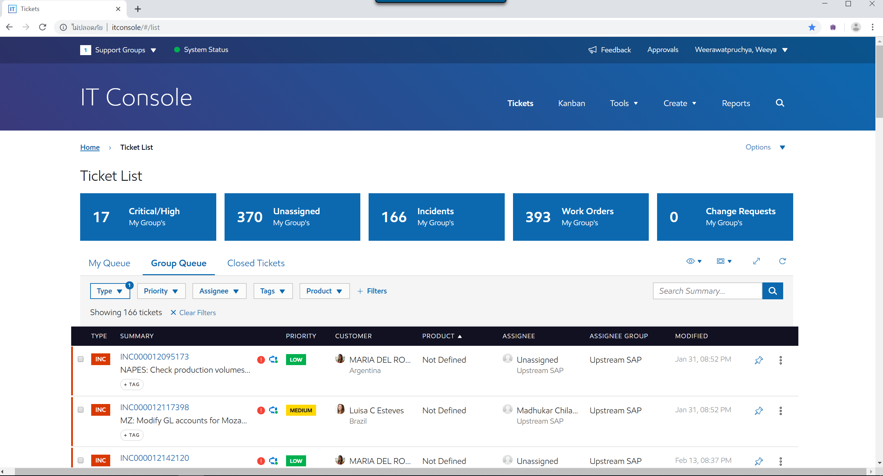

IT Console
Users
Notes:
We have tickets and we have IT console the website for display all tickets from users
And this is the real IT console as you can see display all tickets here… and have a filter
But IT console not suitable for our team structure that have 4 sub team ….. All tickets from 4 team in the same page

Slide 13




Classify & Assign tickets
?
FI Upstream SAP
4 sub-teams
?
Thotsakan
Scrumblers
Supernova
Polaris
Notes:
Let’s see how our team classify & assign ticket
We have 4 dispatcher & hundred of tickets

Slide 14
Pain point & Solution
Team
background
Work
process
Internship
expectation
Pain point
& Solution
Demo
Intern
life

Slide 15
Pain point
1. Manual team classification
2. Unnoticed reassigned ticket
3. All time monitoring
4. Unknown contact point

Slide 16

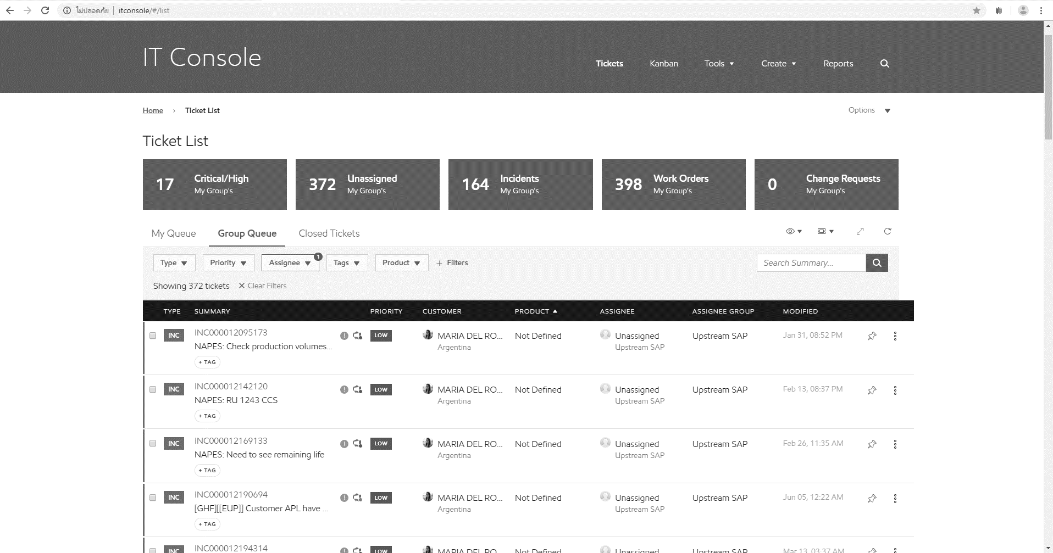
Ticket dispatcher’s life
Notes:
Ticket dispatcher’s life…
In one day ticket dispatcher have to open IT console & start with the first unassign ticket. He have to classify & assign ticket to his team. So he have to read each ticket carefully.

Slide 17
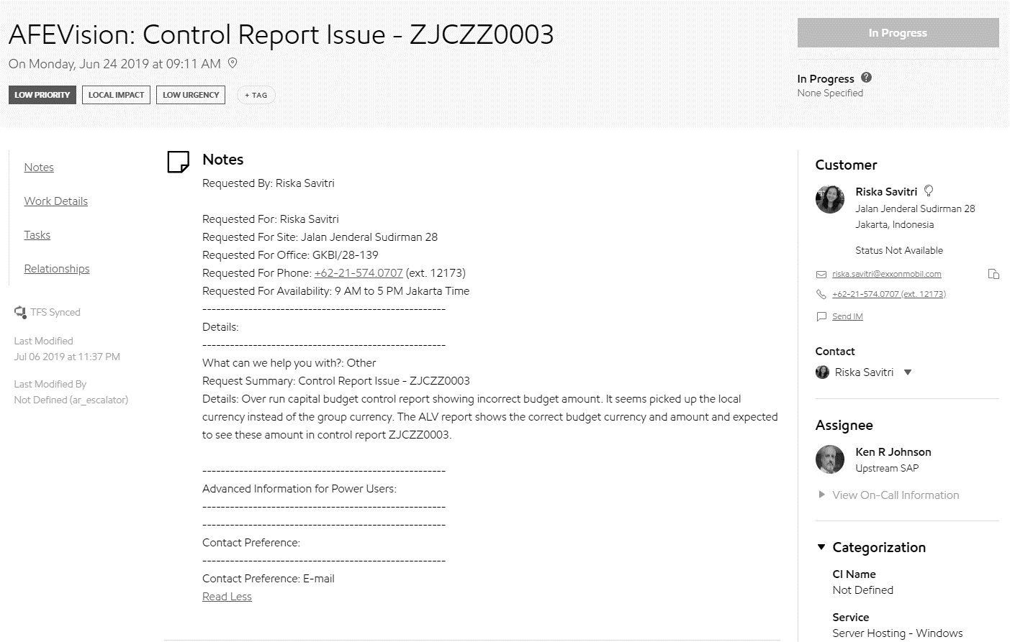
Ticket dispatcher’s life
Notes
Customer
?
Notes:
He start by reading summary & notes line by line to find any keyword, any company code or impacted country & look at customer too.
If the ticket belong to his team he will assign to his team member if not he just skip this ticket and back to fist page.

Slide 18
Ticket dispatcher’s life
1st Pain point
Notes:
And continue doing the same thing ticket by ticket manually
That is the first pain point.

Slide 19
Ticket dispatcher’s life
Yesterday …
INC000012142120
Notes:
He continue reading ticket…
Until the last ticket that he have already done yesterday that he have to remember by himself.

Slide 20
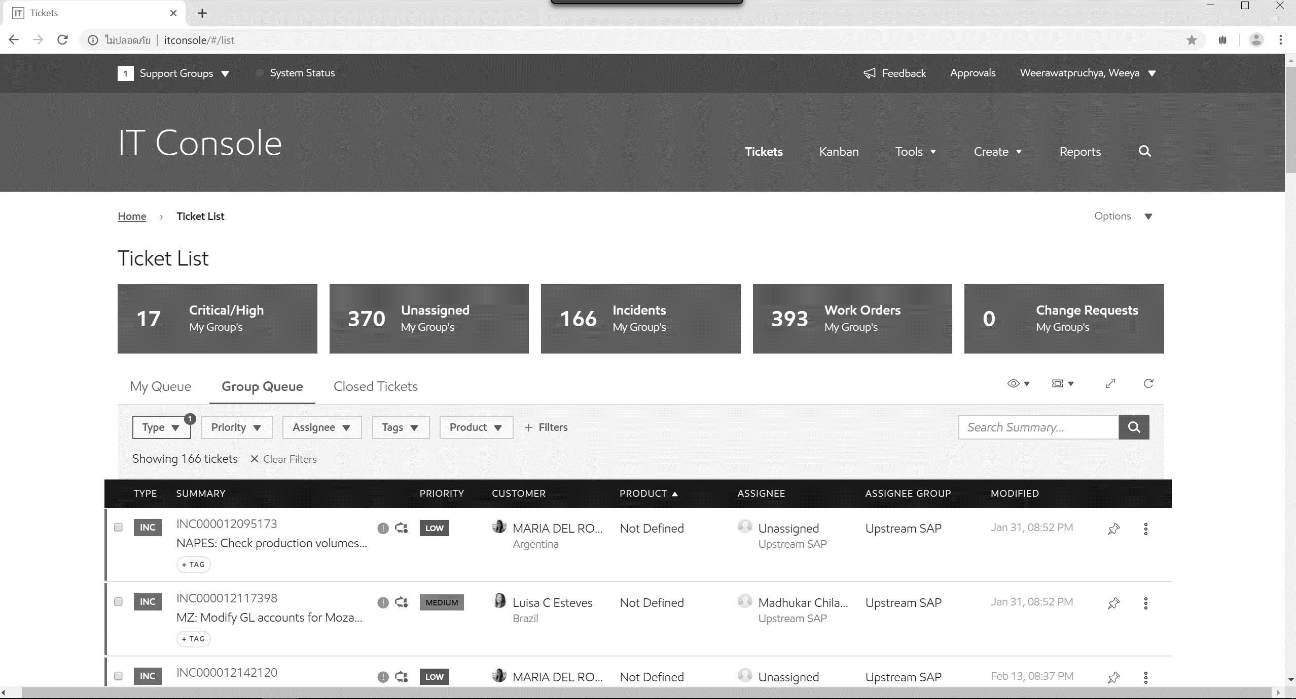
Ticket dispatcher’s life
2nd Pain point
Done
Notes:
Sometime ticket reassign from other support group and it come in the middle … & ticket dispatcher maybe unnoticed that ticket
That the second pain point.

Slide 21
Ticket dispatcher’s life
3rd Pain point
Monitor
IT Console
Notes:
Moreover ticket dispatcher have to monitor ticket all the time … have any new ticket come in
& manually refresh IT Console
That is the third pain point.

Slide 22

Ticket dispatcher’s life
4th Pain point
Contact?
Notes:
Sometime when ticket dispatcher have a problem … for example about reassign to other team
He have no idea who he will contact with.

Slide 23
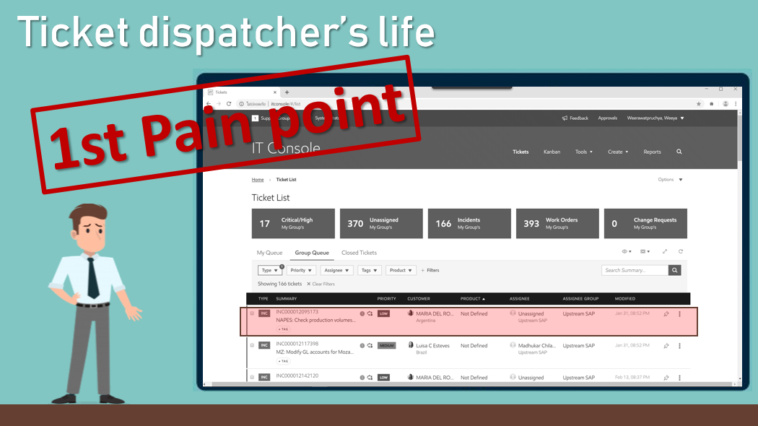
Solution
Ticket
Extract
keyword
Team classification
Classify team
Result

Slide 24
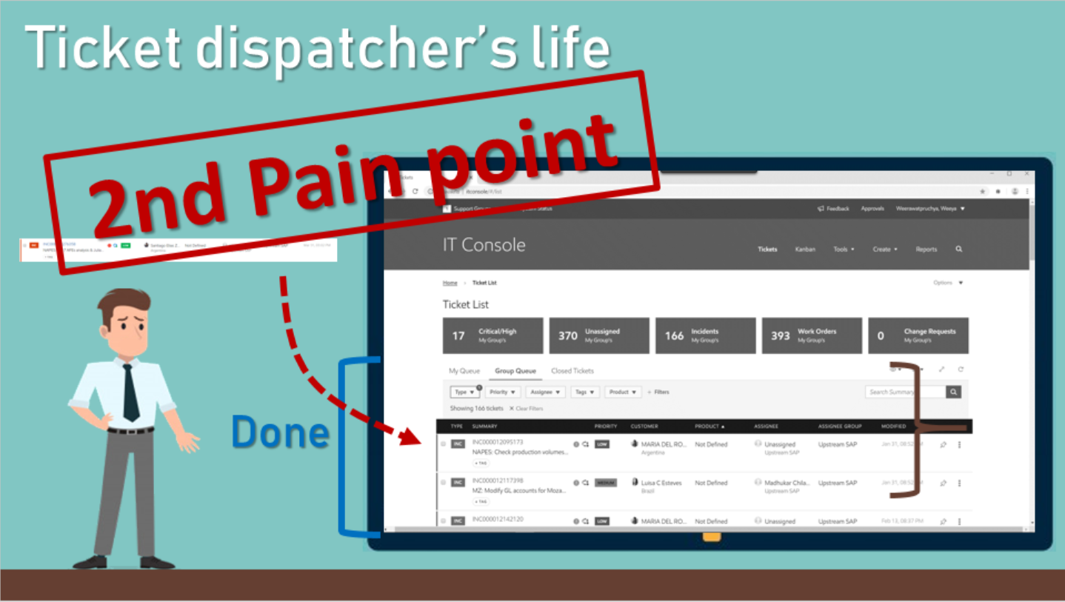
Solution
Sort ticket by modified date
Instead of submitted date

Slide 25
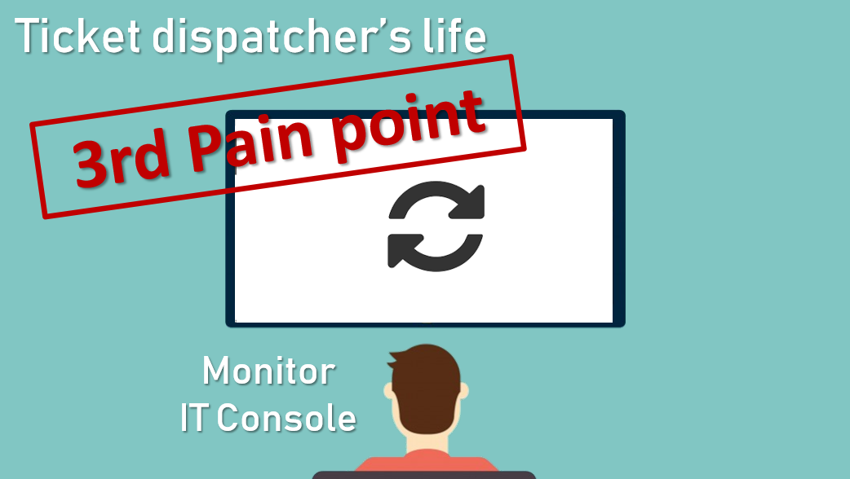
Solution
Notification & Auto refresh

Slide 26
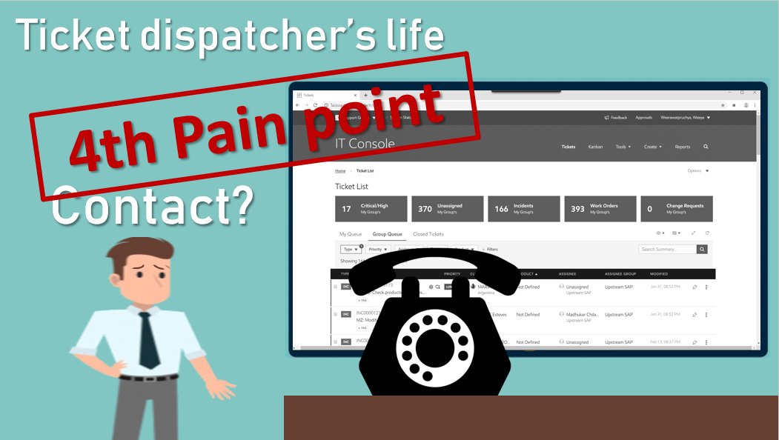
Solution
Display ticket dispatcher

Slide 27
Work process
Team
background
Work
process
Internship
expectation
Pain point
& Solution
Demo
Intern
life

Slide 28




Work process
Agile
methodology
Scrum
framework

Slide 29
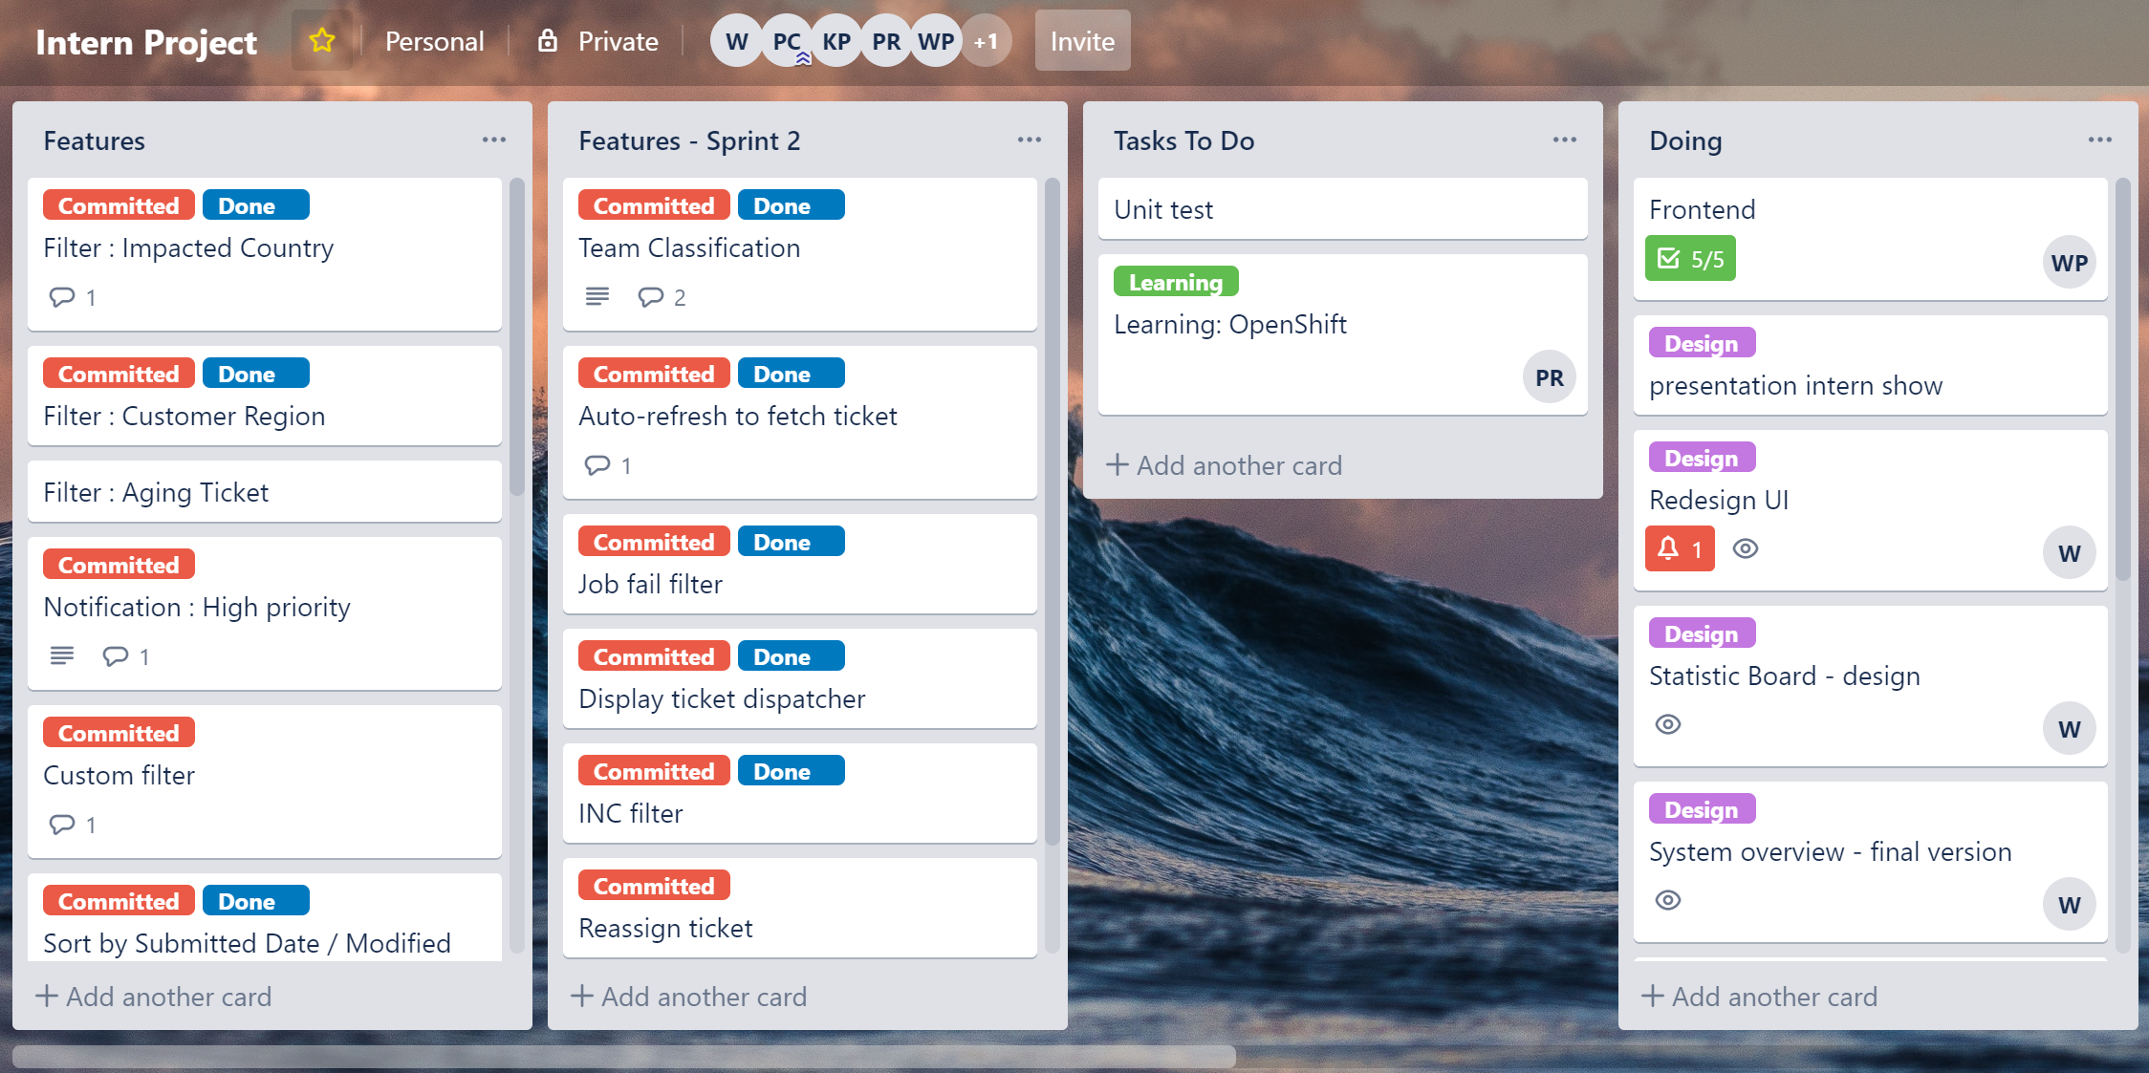

Slide 30
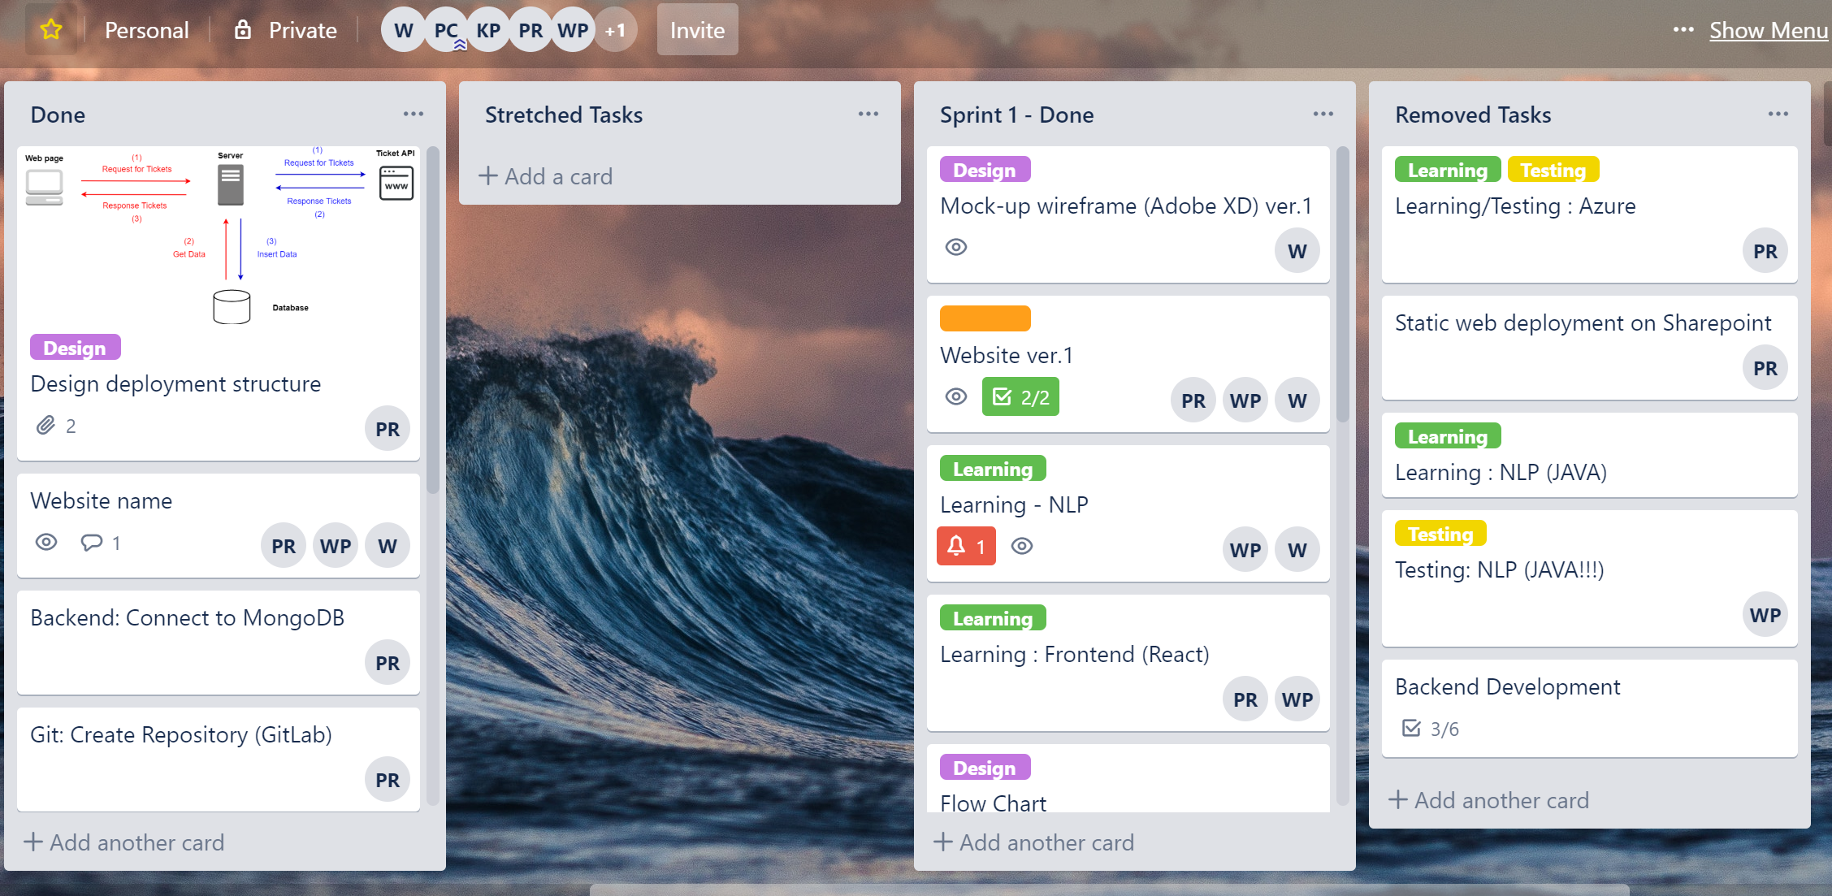

Slide 31
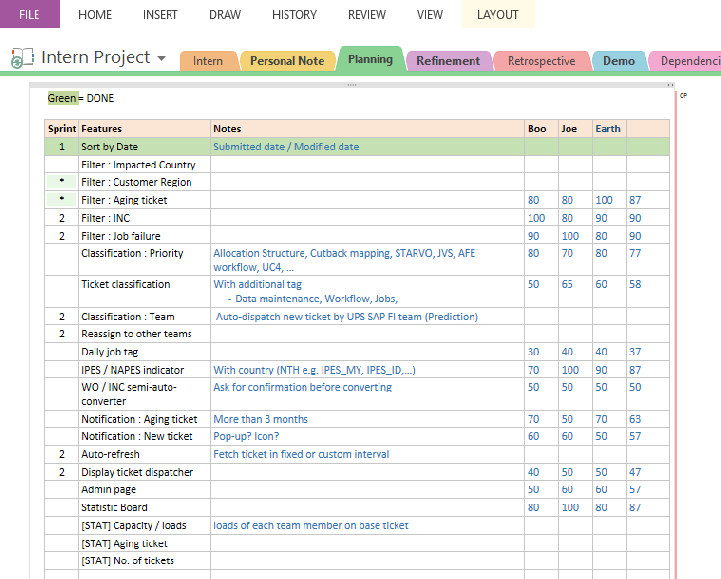
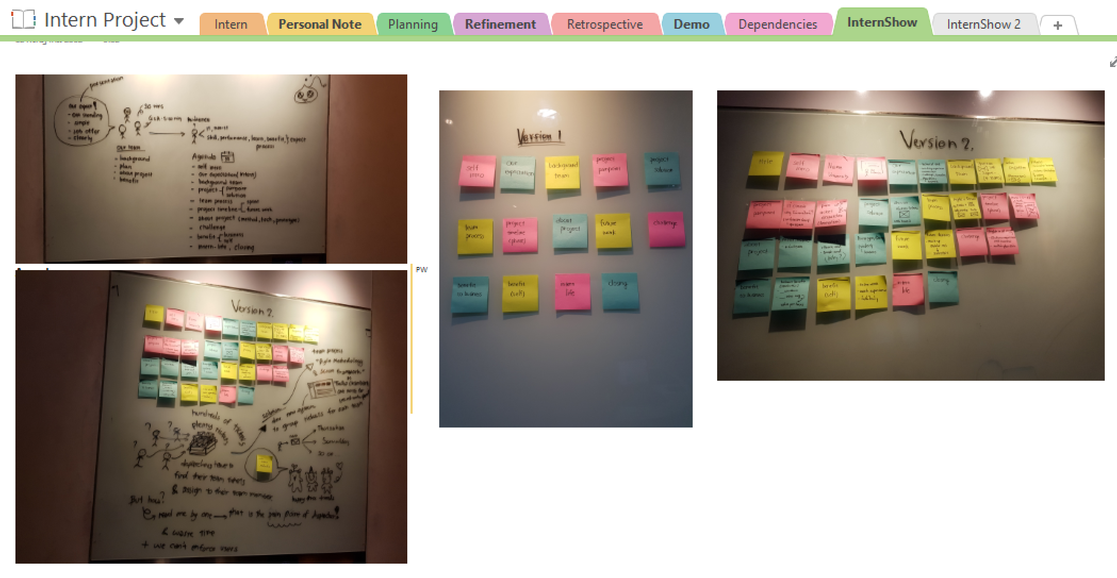

Slide 32
Timeline
Phase 1
Phase 2
2 months
4 months
Team classification
Job failure filter
Auto-refresh
Notification
Reassign tickest
Statistics page
ITSM’s ticket info update

Slide 33
JUNE 2019
3
4
5
6
7
10
11
12
13
14
Sprint 1
17
18
19
20
21
24
25
26
27
28
Sprint 2
Notes:
First two week we learning – tool & compare the best
Request program
Discuss with

Slide 34
JULY 2019
1
2
3
4
5
8
9
10
11
12
Sprint 3
15
16
17
18
19
22
23
24
25
26
Intern show

Slide 35
Phase 1 (2 months)
Sprint 1
Sprint 2
Sprint 3
Gather requirements
Learn development tools
Design wireframe and UI version 1
Design system overview version 1
Make website version 1
Rewrite some logics
Refactor code (optimize and clean code)
Prepare for Interns show presentation
Redesign UI (version 2)
Redesign system overview
Make website version 2
Use version control (GitLab)

Slide 36




System overview
Webpage
Server
Ticket API
Request for tickets
Request for tickets
Respond tickets
Respond tickets
Get data
Insert data
Database
Notes:
this is a system overview diagram so we split them to 2 processes.it will work in parallel mode .Ok, first we look at the red one. when we open the webpage, it's will request a ticket from backend server and the server will query ticket from database and respond tickets back to the webpage and show them to user so next the blue one is backend process first the backend request all upstream tickets from its console and it's console respond tickets to backend server to classify the team ticket and add team attribute into tickets then store them to the database

Slide 37

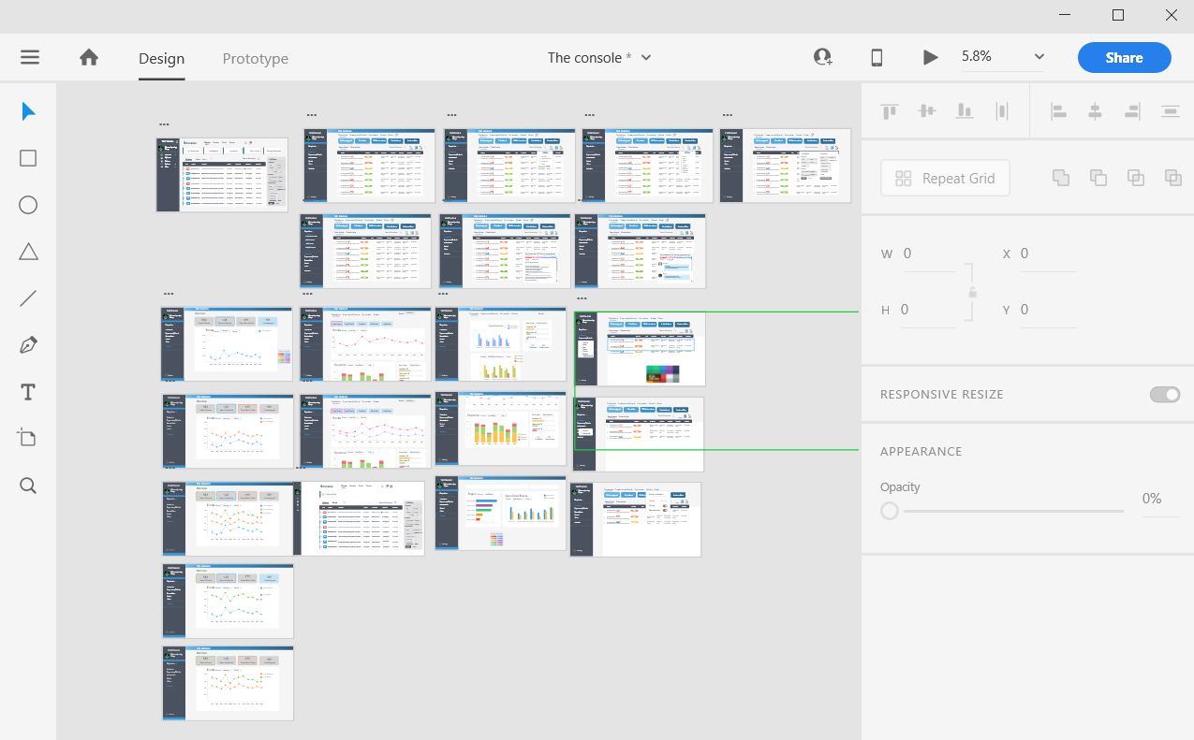
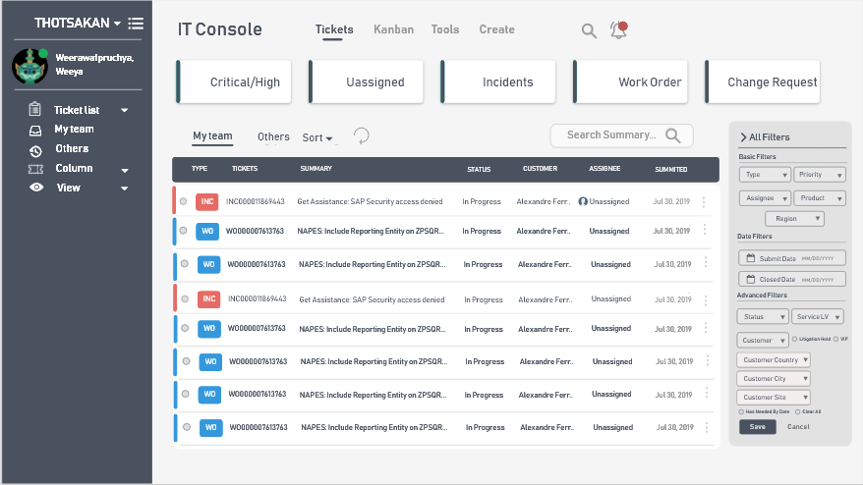
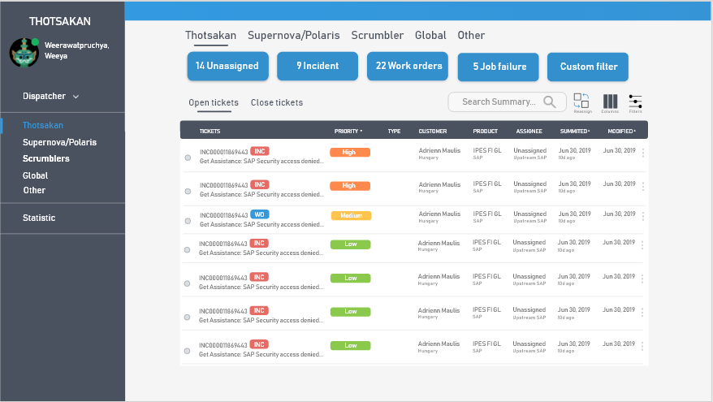
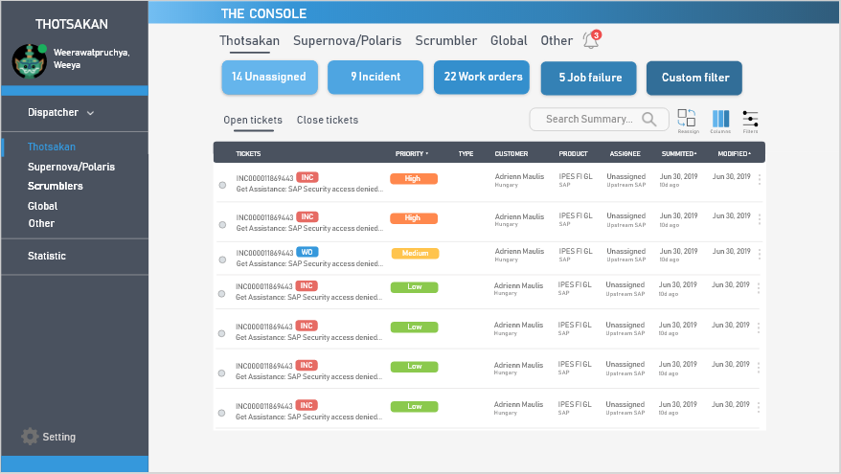
Technologies – Design
Website wireframing
Creating simple interactive click-through prototypes
Adobe XD
Team
Menu bar
Display tickets

Slide 38


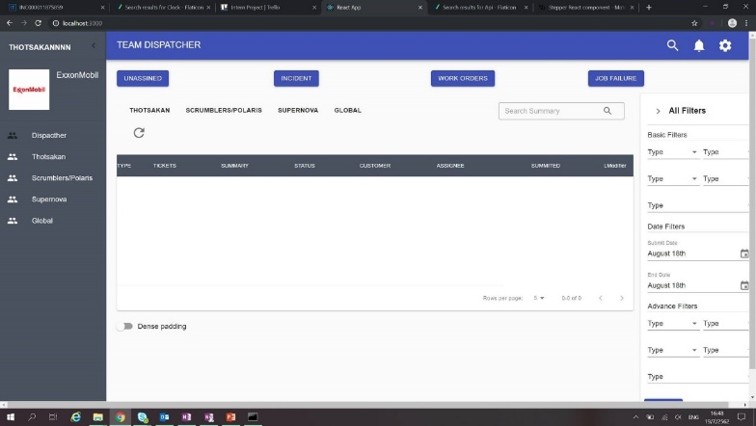
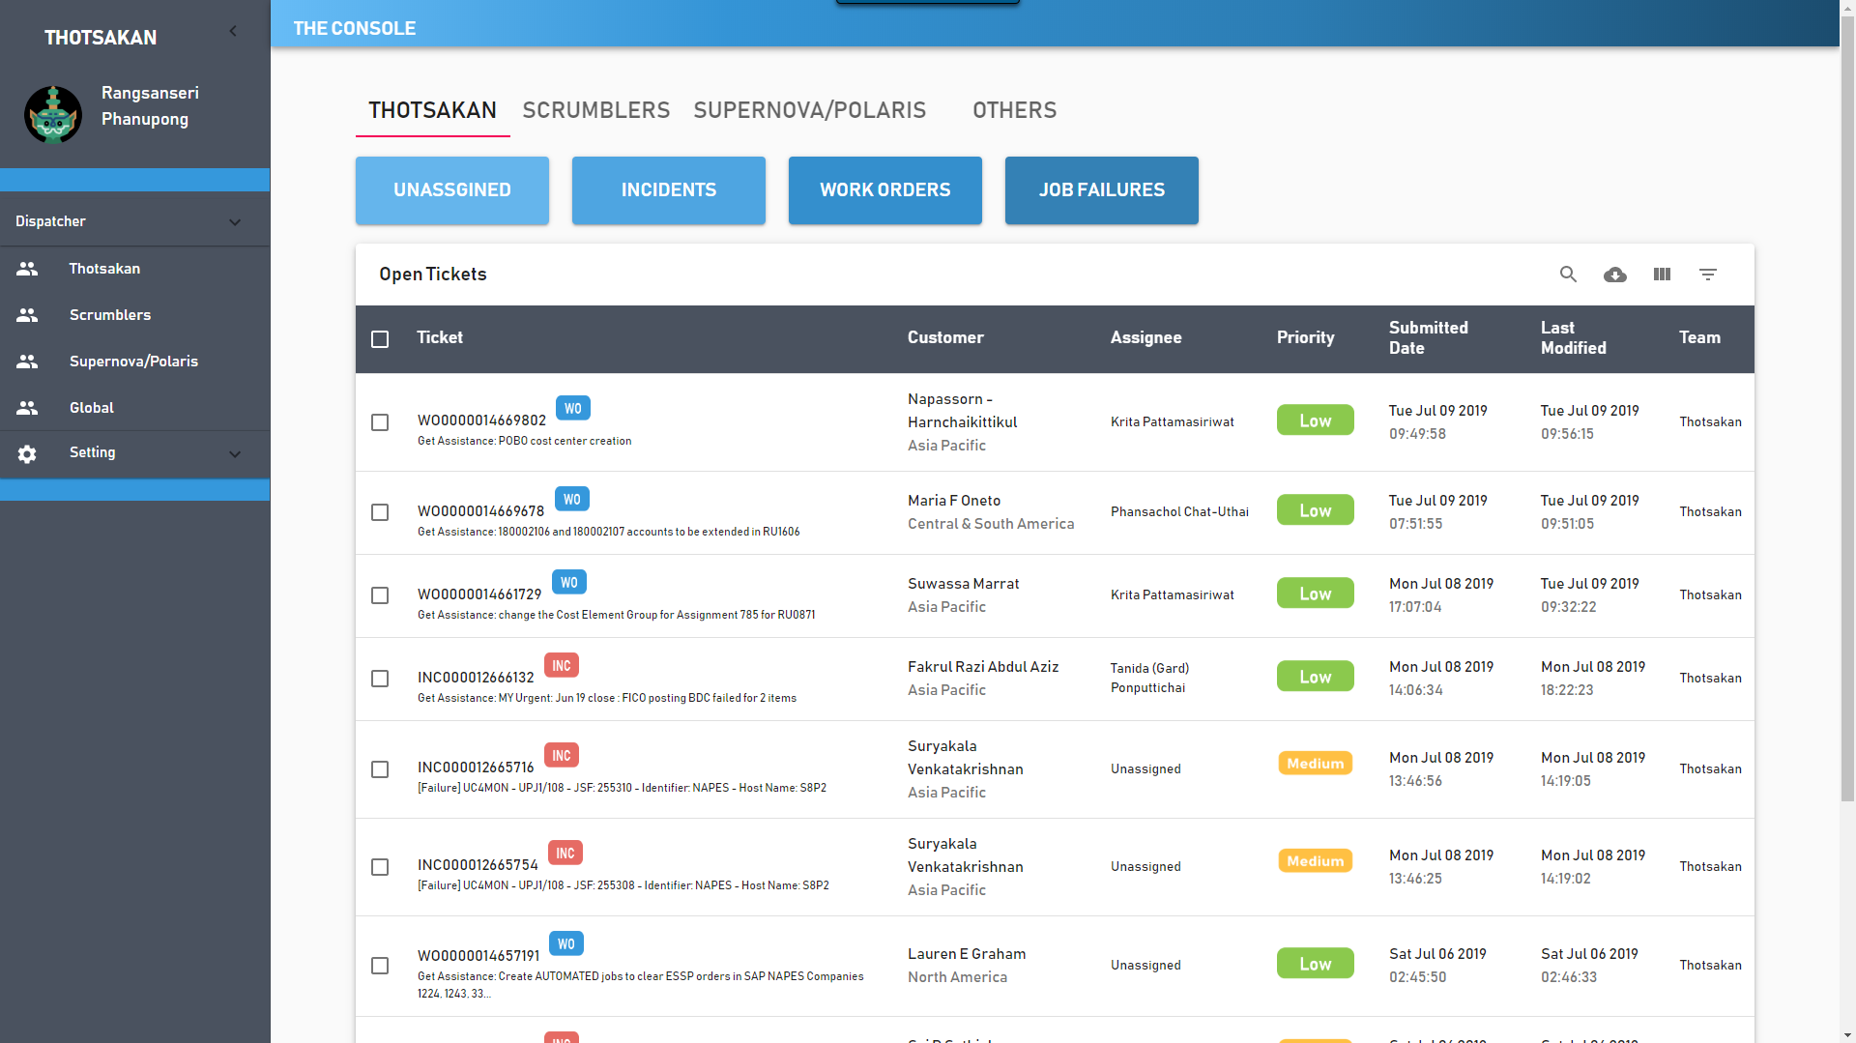
Technologies – Front End
React
Building website user interfaces

Slide 39


Technologies – Backend
Python
Python: extract texts and classify team
Flask: for deployment to the web server

Slide 40

Technologies – Database
MongoDB: store tickets data

Slide 41
Demo
Team
background
Work
process
Internship
expectation
Pain point
& Solution
Demo
Intern
life

Slide 42
Home page

Slide 43
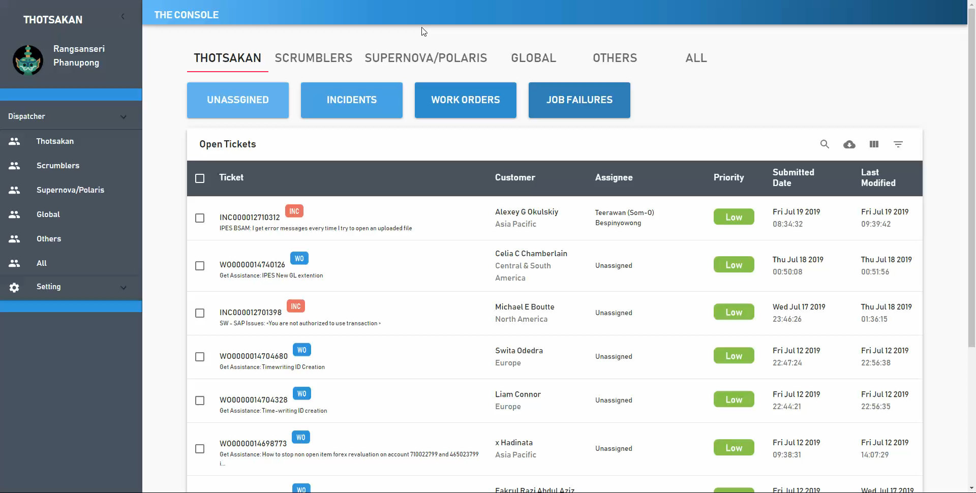
Team classification

Slide 44
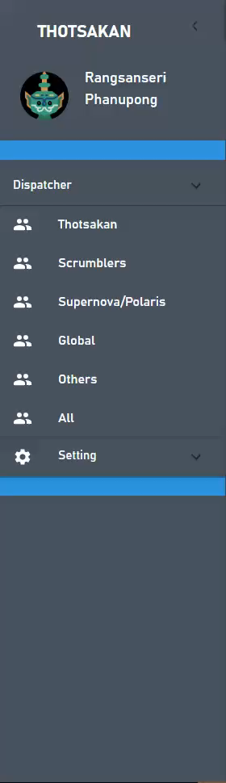
Display dispatcher

Slide 45
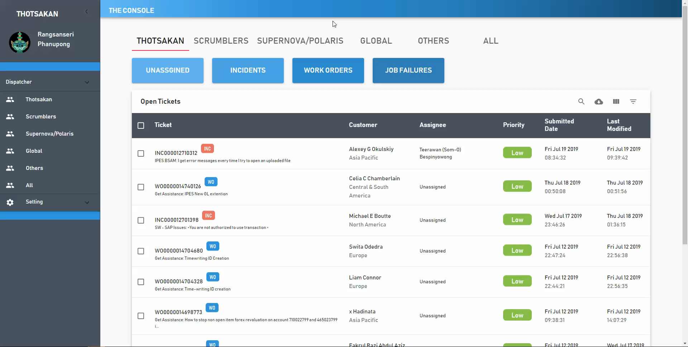
Auto refresh

Slide 46

Job failure filter

Slide 47
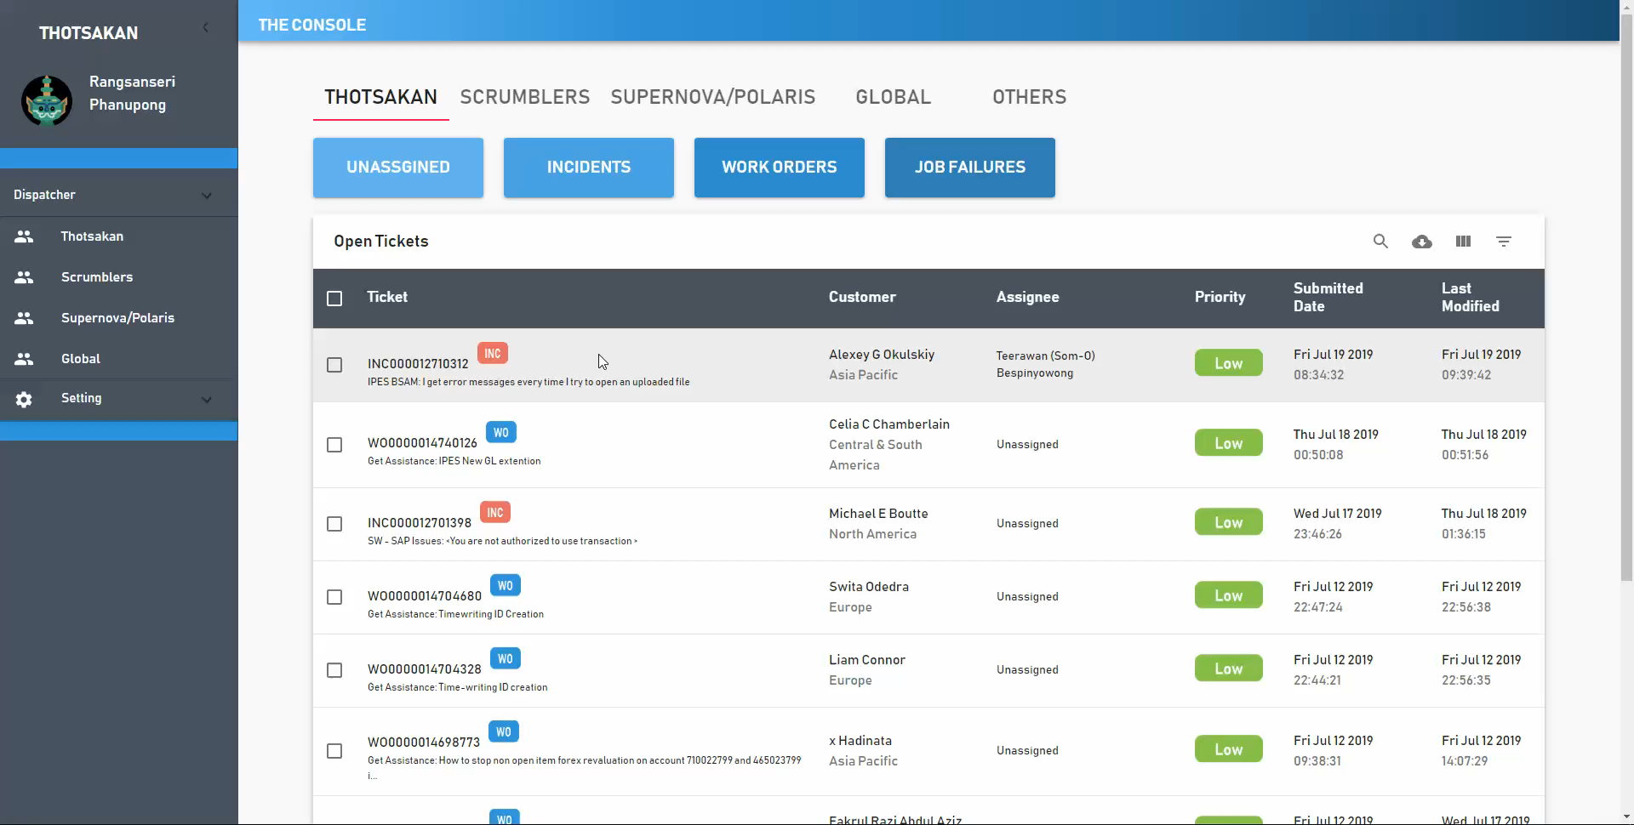
Ticket detail

Slide 48
Future work
Phase 2 (4 months)
Notification
Statistics page
Reassign tickets
ITSM’s ticket info update
Notes:
Statistics and deploy

Slide 49
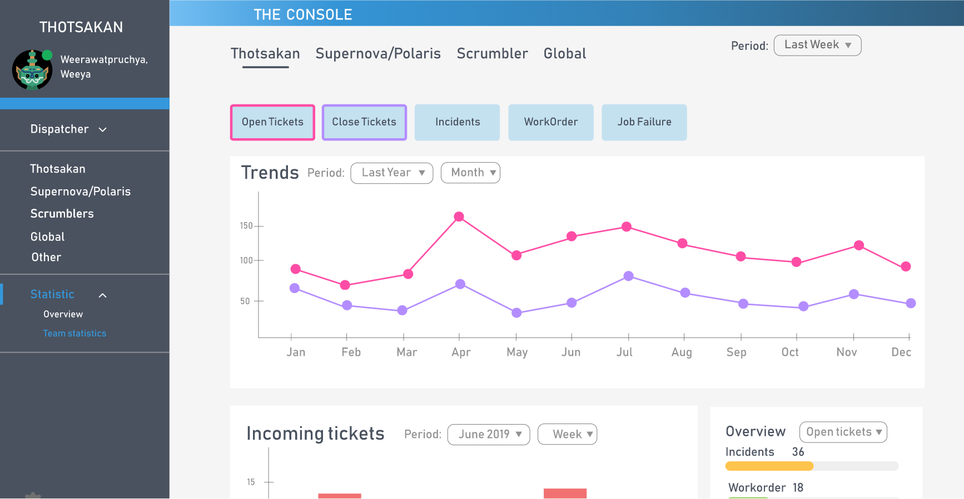
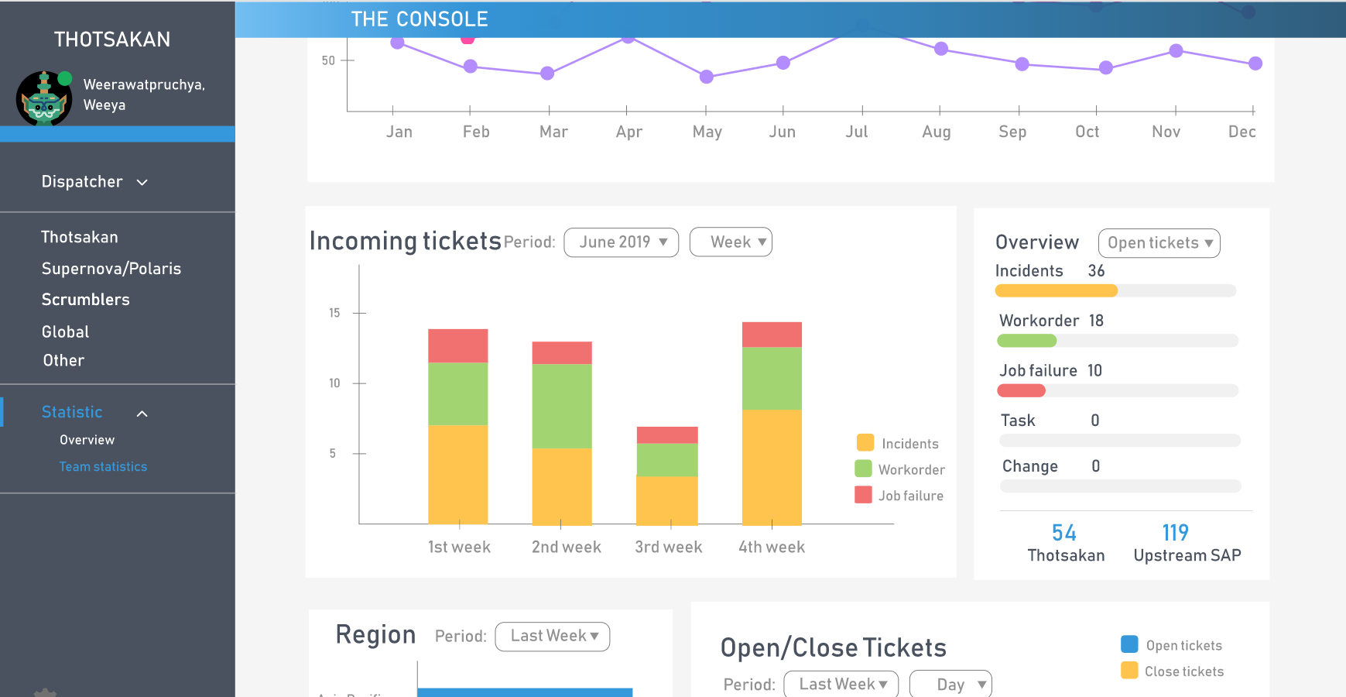
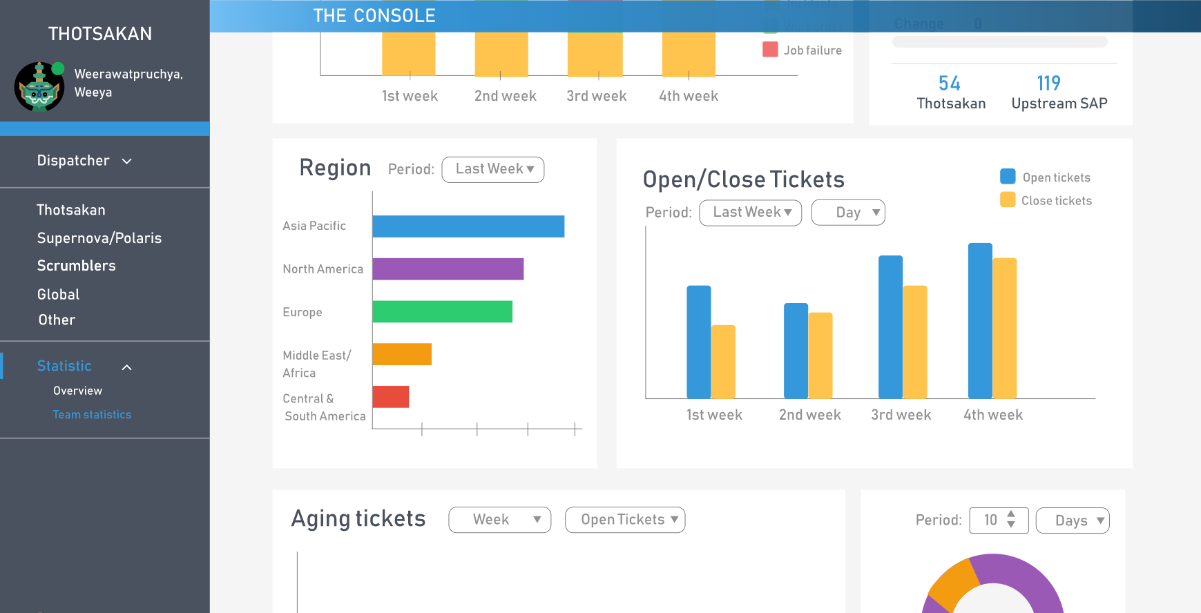
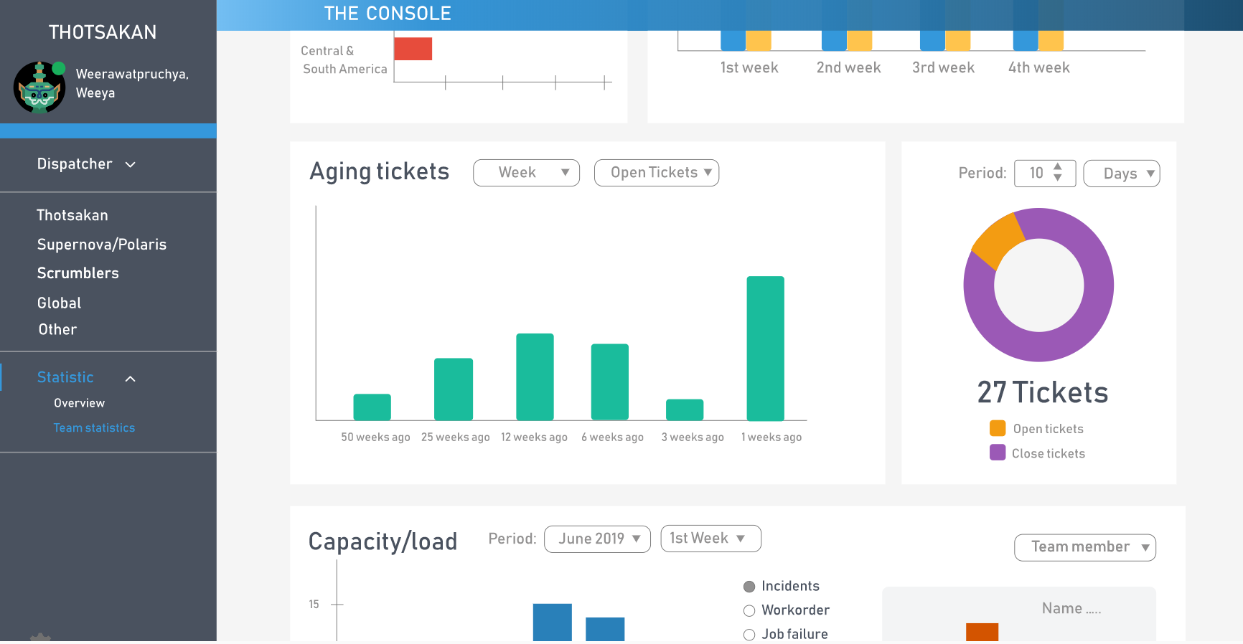

Slide 50


Benefit to team
Reduce time usage
Reduce effort
~400 tickets per month
4,800 tickets per year
TDAS: ¼ of tickets
(100 tickets/ month)
Notes:
Reduce time reduce effort
Improve efficiency
X min per ticket
If we have 10 ticket per day == 50 mins but in real life ticket doesn’t continuously come ticket dispatcher have to monitor… worry

Slide 51
Accuracy
87.5%
From 40 tickets example (closed ticket)

Slide 52


Challenge
Collaborations with new friends
Adapt to project's requirement changing
Time limitation
Speak English

Slide 53
Intern Life
Team
background
Work
process
Internship
expectation
Pain point
& Solution
Demo
Intern
life

Slide 54
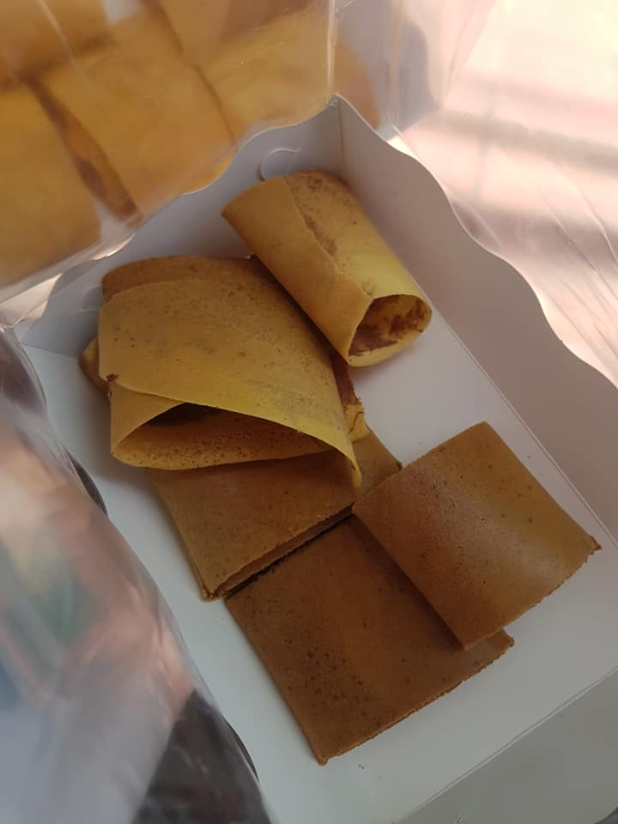
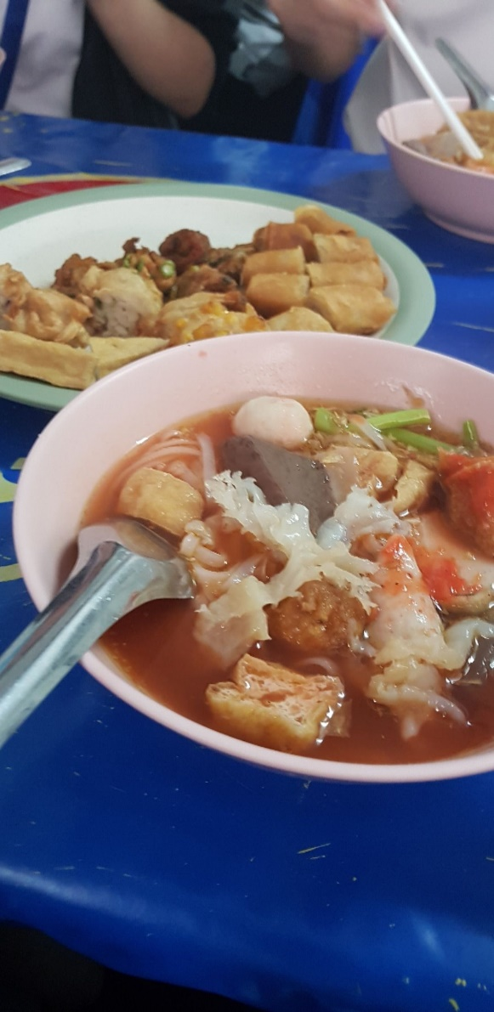
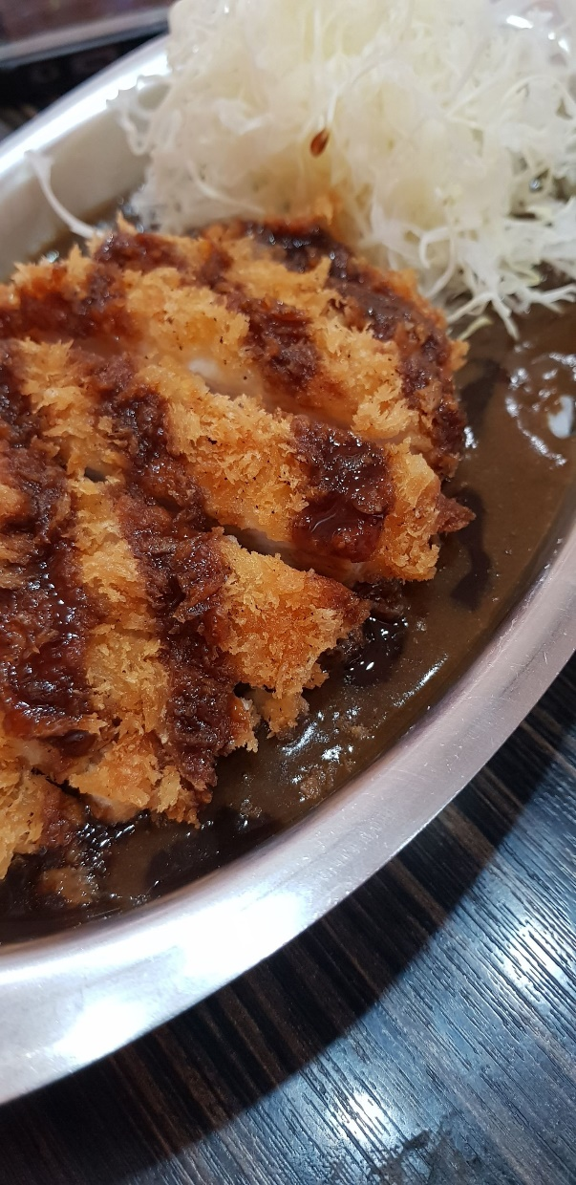

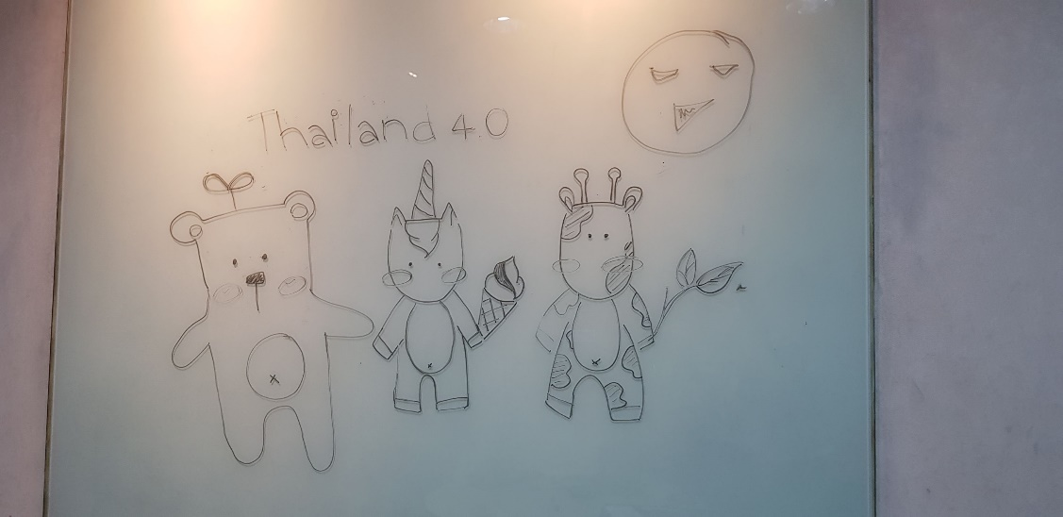
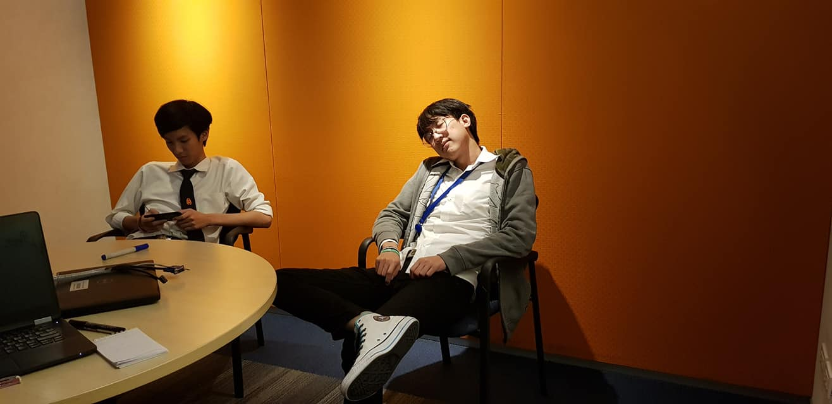
Notes:
In exxonmobil we didn’t do only work, we also do activities with our friends. We have lunch together

Slide 55
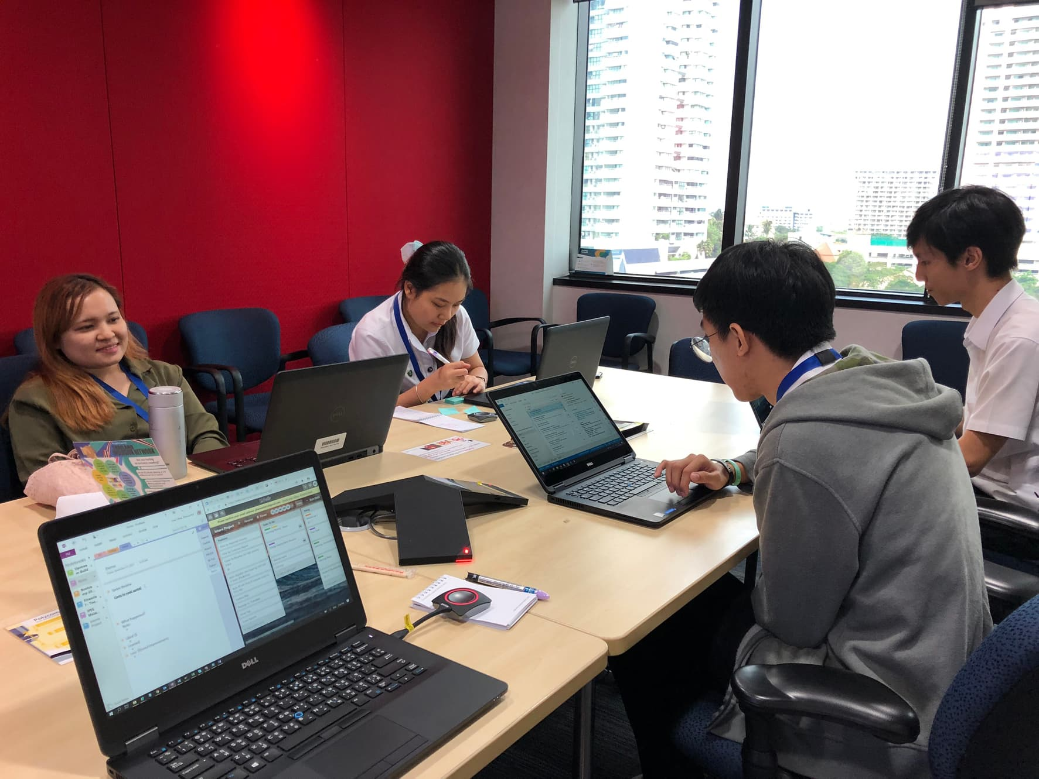
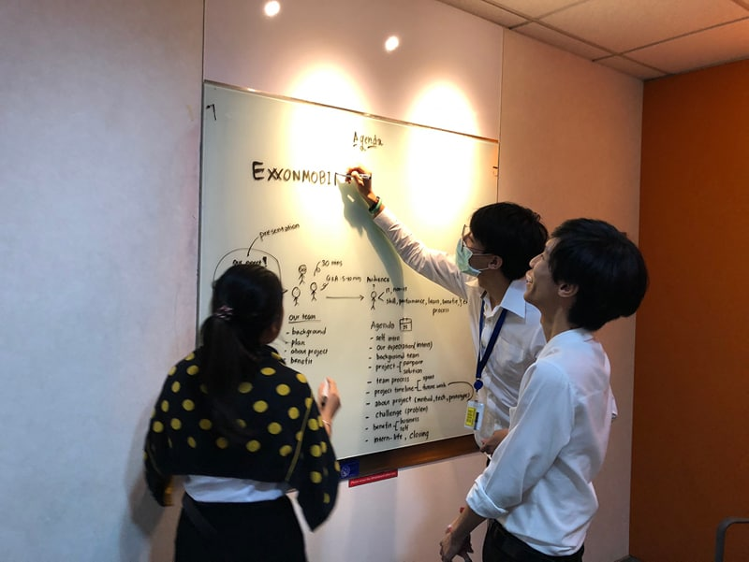
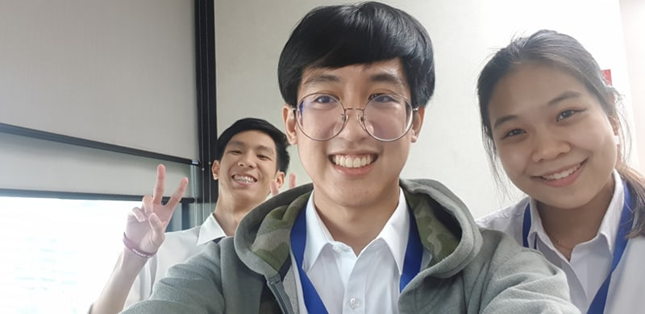
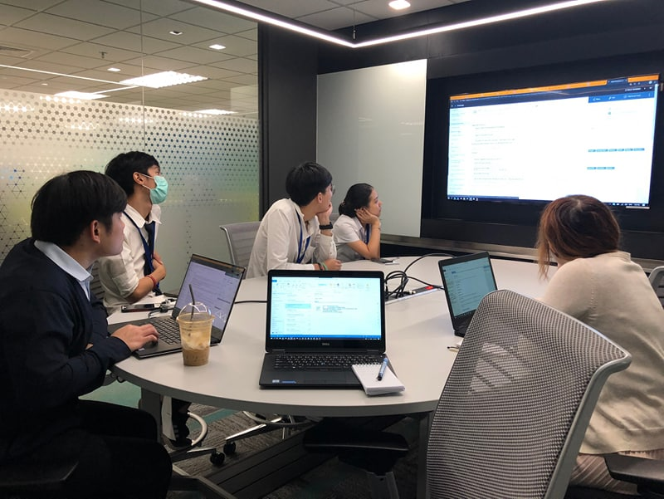
Notes:
Work together

Slide 56
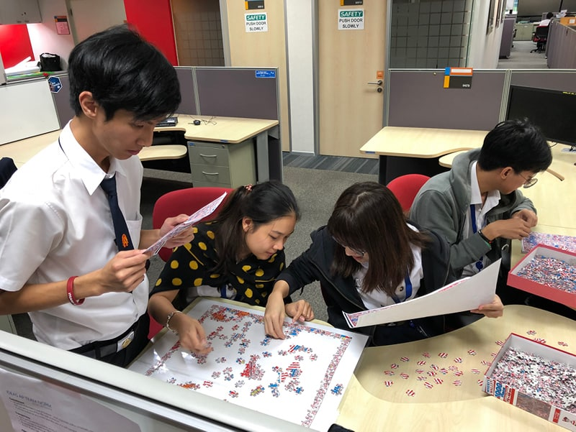
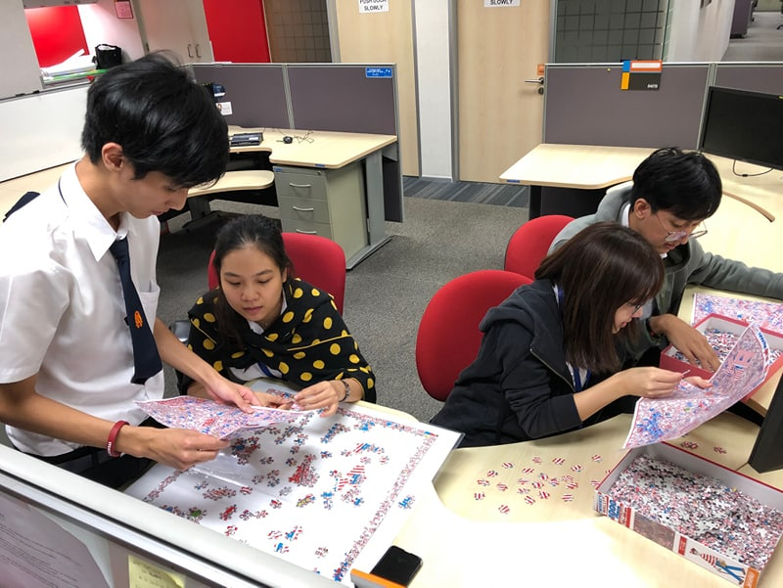
Notes:
And we play jigsaw together, its very funny

Slide 57
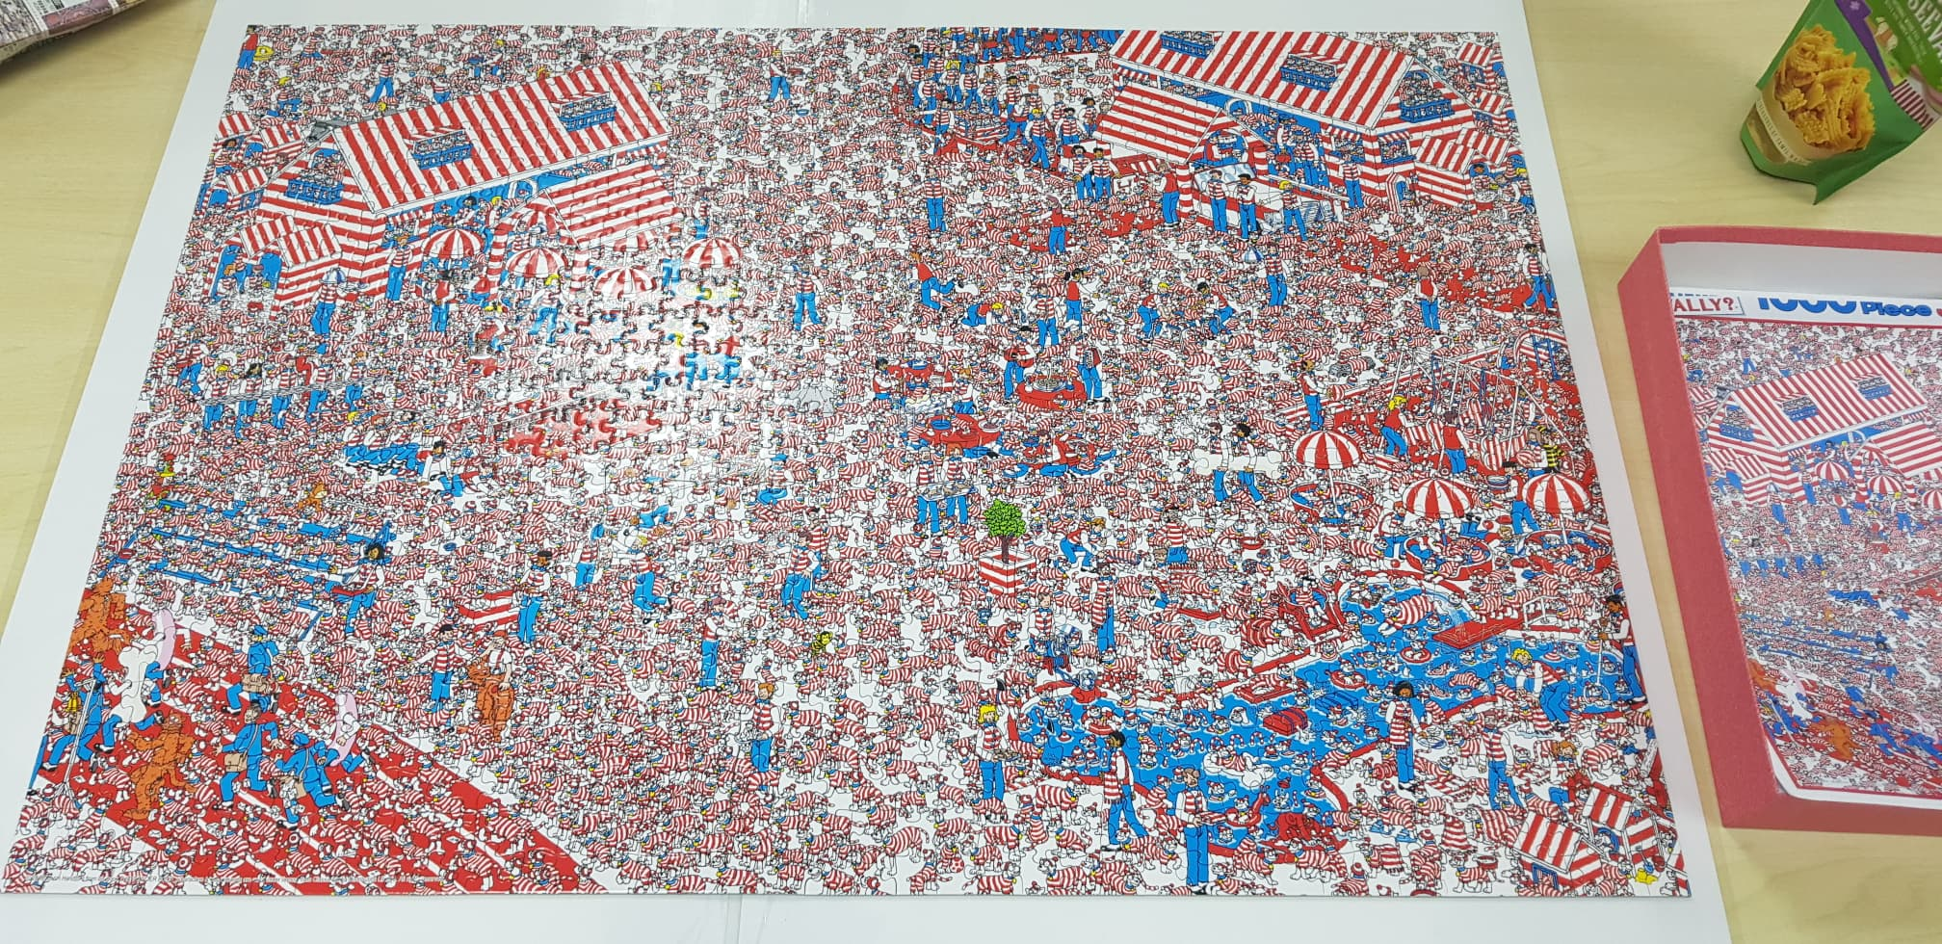

Slide 58


What have we learned ?
Technical
skills
Working
experience
New friends
Finding myself
Notes:
What have we learned from internship ?
Joe: I learned about how to create website and how to use agile to develop software
Earth:
Boo:
Working experience:
we encountered with real work environment, pressure, time limitation and finally we can handle it.
New friends:
We met a lot of new friends from this internship. We know how to work with others
Finding myself:
from this internship, we didn’t know what we like. We want more time to find ourselves
And more….
We also learned about how to make a good presentation, improve English language skill such as, we use English in all agile ceremonies, writing email.

Slide 59
“If you only do what you can do,
You’ll never be better
Than what you are.”
-Master Shifu-

Slide 60
Q & A

Slide 61
Backup
TDAS

Slide 62
Criteria
Thotsakan
impacted country is in Asia pacific
customer region is Asia pacific
SAP server is IPES
Scrumblers
impacted country isn’t in Asia pacific
customer region isn’t in Asia pacific
SAP server is IPES
Supernova/Polaris
sap server is NAPES
Other
assignee is not in any team
note don’t have sap server keyword
note don’t have impacted country keyword
customer country is in GBC country
Global
sap server is IPES and NAPES
note have global keyword such as YFGLJV01
Notes:
Other: can’t classify and dispatcher from all team have to classify by theirselve
Global: who see this ticket first should do that ticket

Slide 63
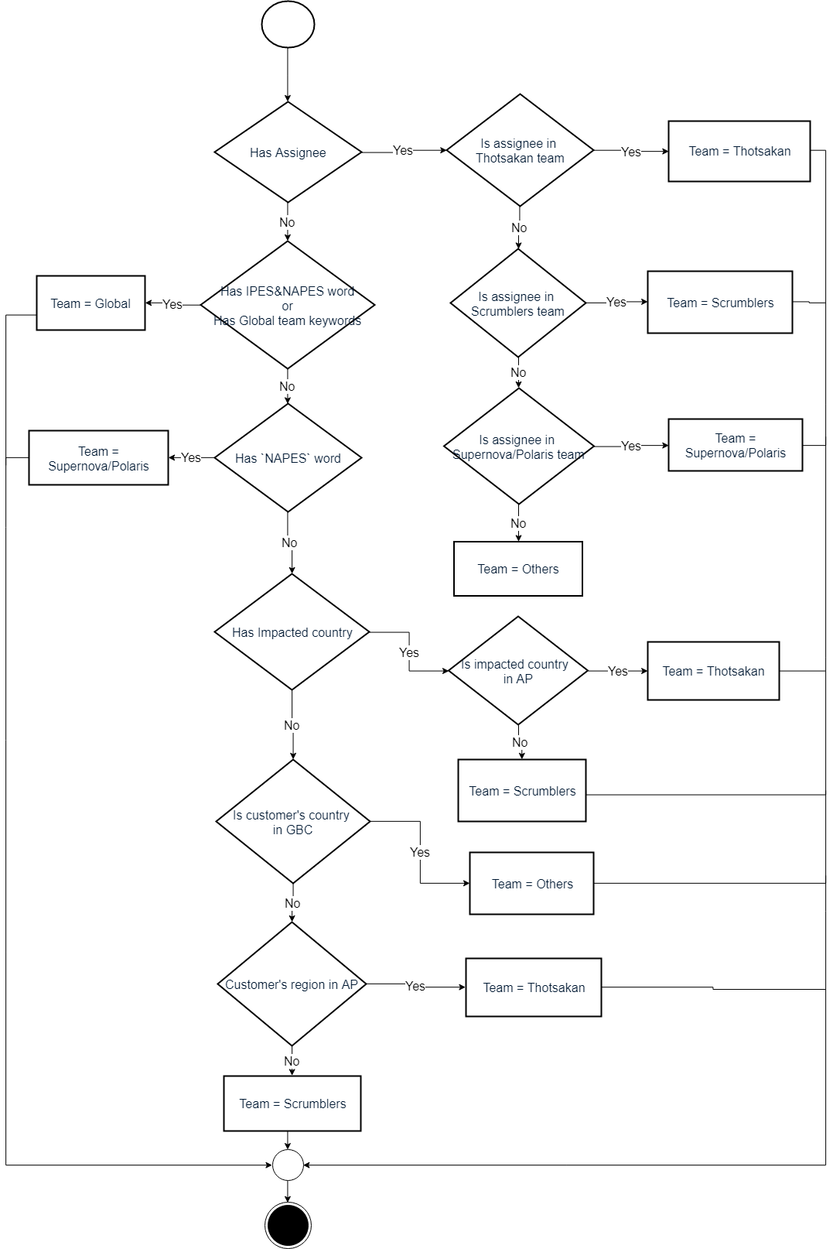

Slide 64
ITSM’s ticket info update
Phase 2
3.Update tickets
4.Update tickets
2.Respond tickets
1.Respond tickets
Webpage
Server
ITSM

Slide 65

Role & Responsibility
Boo
Joe
Earth
Design
Frontend
Backend
Text processing
Backend
API

Slide 66
